Slide 1
Analysis On Electric Vehicles
By
P SRI Sai SATHVIK

Slide 2
Introduction Of This Project
https://www.zigwheels.com is a automobile website that includes all Petrol, Diesel Electric Cars and Bikes
It is also having a chat assistance available which helps in case of difficulty.

Slide 3
AGENDA
Problem Definition
Objective of the Project
Web Scraping – Details (Websites, Processor you followed)
Summary of the Data
Exploratory Data Analysis:
Data Cleaning Steps
Data Manipulation Steps
Data Visualization Steps
Key Business Question
Conclusion (Key finding overall)
Q&A Slide
Your Experience/Challenges working on Web Scraping – Data Analysis Project

Slide 4
About ME
Name : P.Sri Sai Sathvik
Qualification: B.Tech From GITAM
As we all know that we are living in a Data-Driven world, Any business, big or small is looking for skilled people in the field of Data-Science who can comprehend and deconstruct data. It is the very reason that, I have a natural bonding with Maths and Data.
Experience: Aspiring to become Data Analyst

Slide 5
Problem Statement
A problem statement is the clear description of the problem that you are trying to solve based on the client’s insight. This will be the starting point for decision making.
Key Problem statements:
What are the Companies manufacturing EV Vehicles?
What Criteria should be verified while selecting a vehicle?
How the price will be decided by the company?

Slide 6
Objective Of The Project
Electric Vehicle price analysis based on several factors.

Slide 7
Web Scraping Details:
Website scraped: auto.hindustantimes.com
Link : https://auto.hindustantimes.com/new-bikes/electric-bikes
Libraries/Techniques used:
Data Collection → BeautifulSoup, requests, Regex
Data Cleaning → Pandas, Numpy.
Data Visualization → Matplotlib, Seaborn

Slide 8
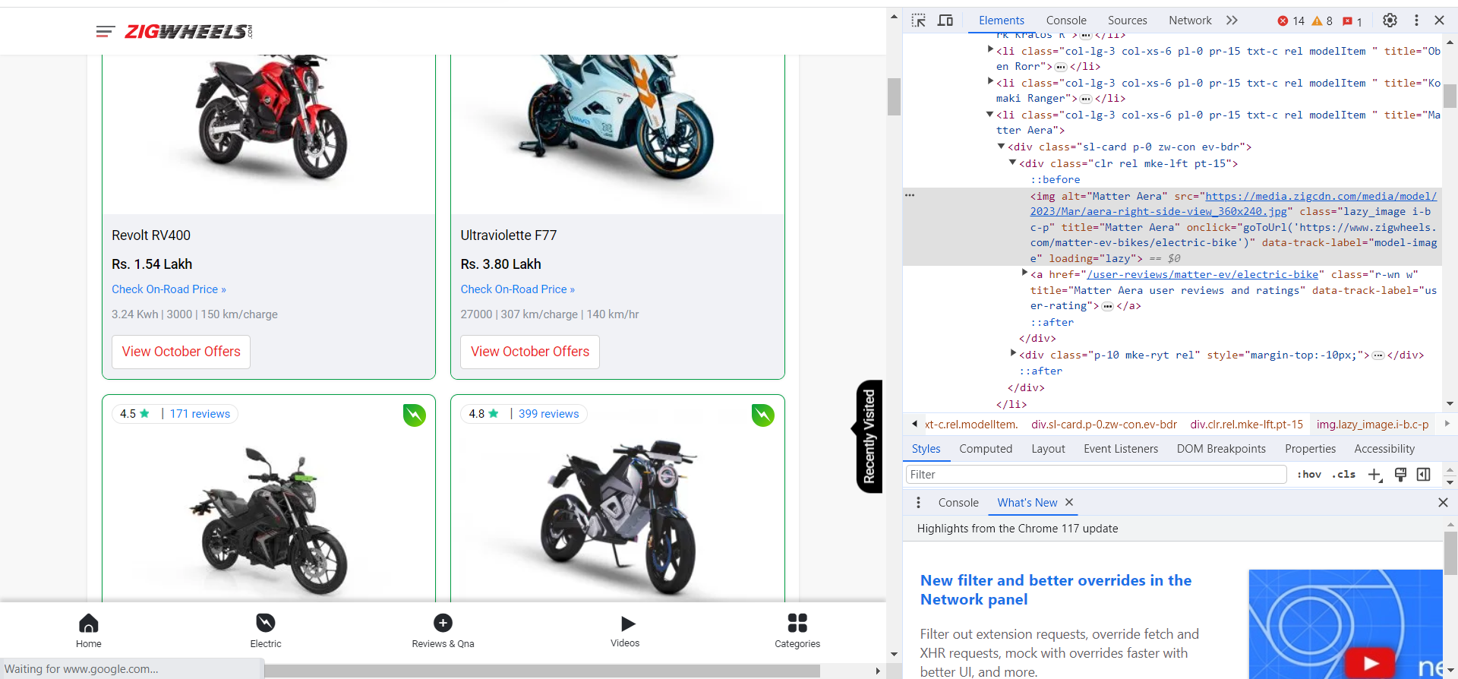
WEB SCRAPING

Slide 9
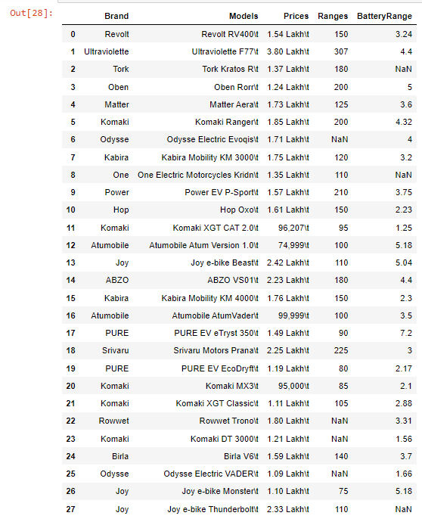
RAW DATA Collected

Slide 10
Summary Of the Data
The Data-Collected is a raw data from MagicBricks.com which contains Null-Values(NaN’s), Empty spaces and Corrupted data. The total number of rows obtained are 156 rows and columns are 5.
Initially the Data will be of dtype → object, we need to clean the data and convert them into their respective dtypes.2
The Column Variables are:
1. Brand
2. Model
3. Prices
4. Range
5.BatteryRange

Slide 11
Data Cleaning Steps:
Data Cleaning Involves the following steps:
Step 1: Check for Duplicates:
Find the Duplicates and drop them, keep preference as first.
Step 2: Identify the Corrupted Data:
Remove the Corrupted values, symbols or text etc..,
Step 3 : Handling missing values:
Identify missing values using `isna()` or `isnull()`
View the missing values
Replace the missing values after changing the dtypes of the columns with respective Mean(), Median(), Mode().
Step 4 : Handling Outliers:
Find the skewness for each column and based on the value move forward.
Identify the Outliers using IQR method and view them.

Slide 12
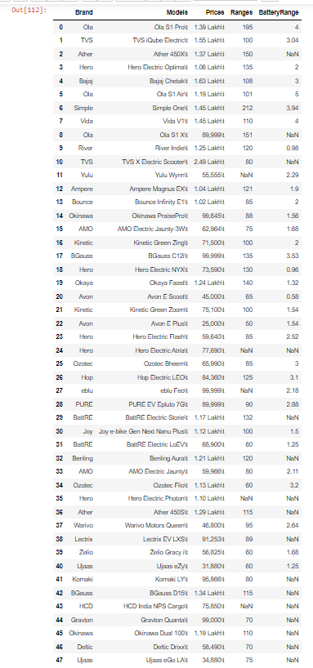
Cleaned Data

Slide 13
Data Manipulation
Data Manipulation contains the following steps:
Type Casting of Data Frame columns to the respective dtypes.
Filtering the Dataset according to the need for better understanding.
Data Frame operations like `Column Renaming`, `Dropping rows and columns`, `Resetting index` etc..,
Sorting the data in a data frame.
Applying string operations, Array operations , list operations etc.., on the data.

Slide 14
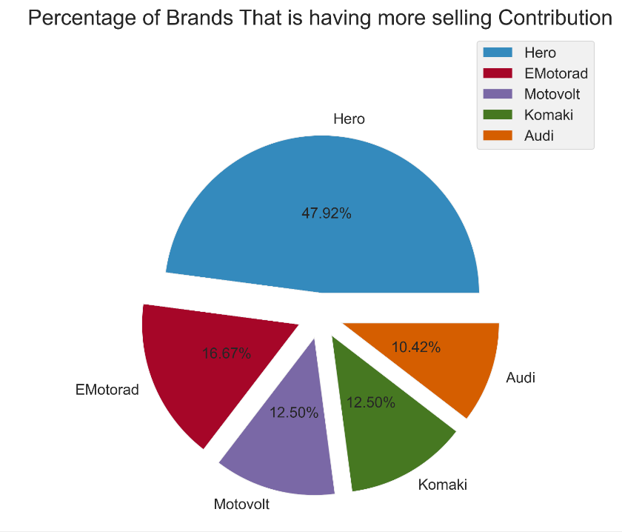
DATA Visualization
Observation:
From The Above Bar Graph We Observe That Hero Brands are having more Selling Contributio as compared to remaining Brands

Slide 15
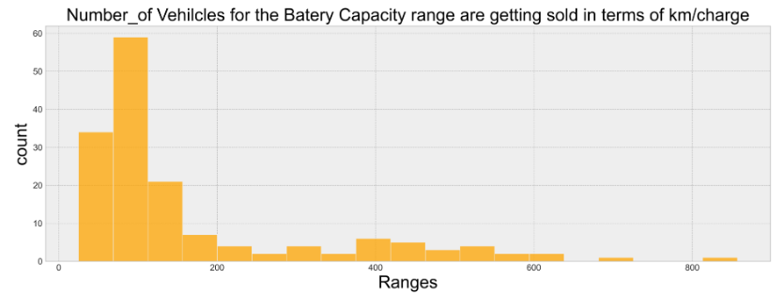
Observation:
From The Above Graph We Observe That More Vehicle are getting sold under the range of 50-150 km/charge and also at 100km/charge approx. 60 vehicles got sold

Slide 16
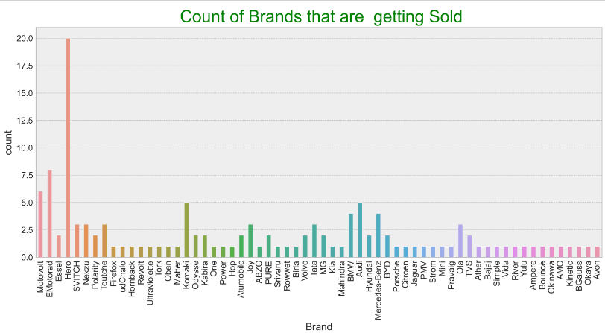
Observation:
From The Above Bar Graph We Observe That Hero Brands are getting more sold as compared to other brands

Slide 17
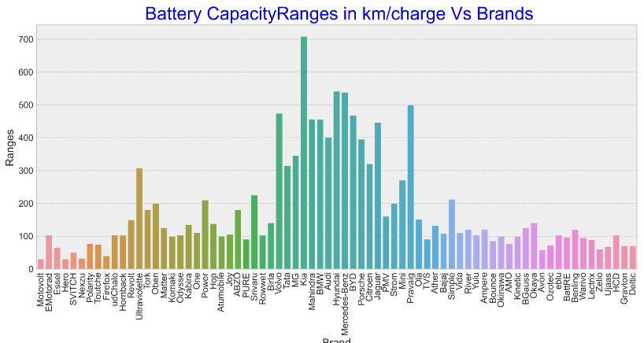
Observation:
From The Above Bar Graph We Observe That Kia Brand is having more Battery Capacity Range as compared to remaining Brands

Slide 18
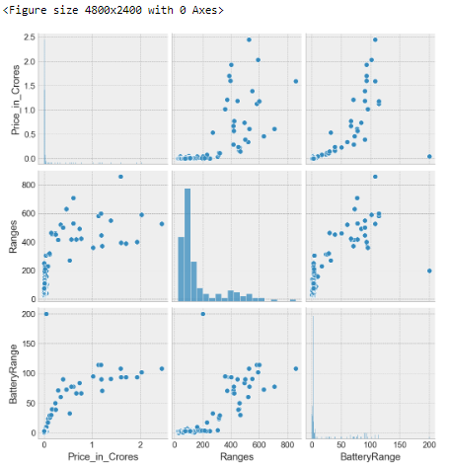
Observation:
From The Above Graph We Observe That is more people are buying more Battery Capacity Range from 0 – 200 km/charge and battery consuming range from 2.5 – 7.5 Kwh under the price of 20 – 70 lakhs

Slide 19
CONCLUSIONS:
From the EDA and Data Visualization the following conclusions are drawn:
1. Most of the customers are buying Hero Brands
2. Kia is having more battery capacity range i.e., 700 km/charge
3. From the above analysis customers can either buy Hero brands or Kia Brands

Slide 20
Q & A Slide

